Slide 1
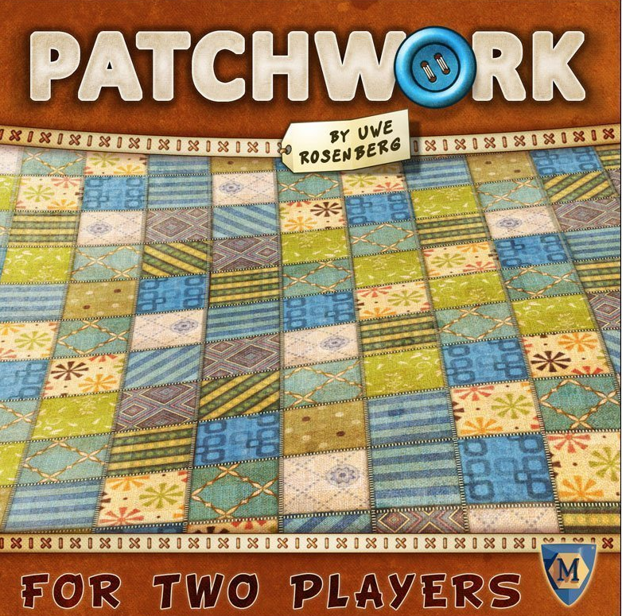
Reinforcement Learning in Patchwork
Browning Gentry

Slide 2
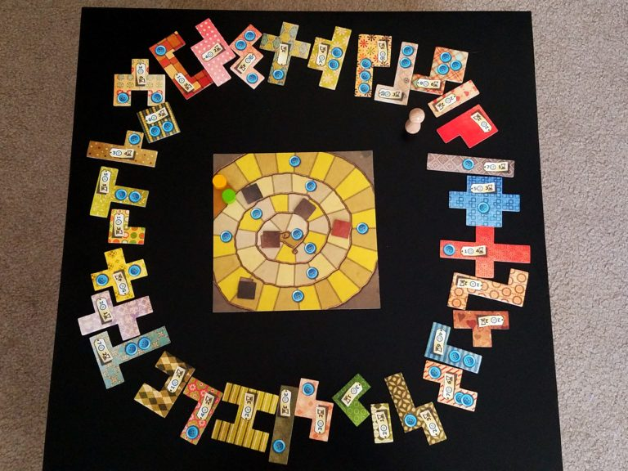
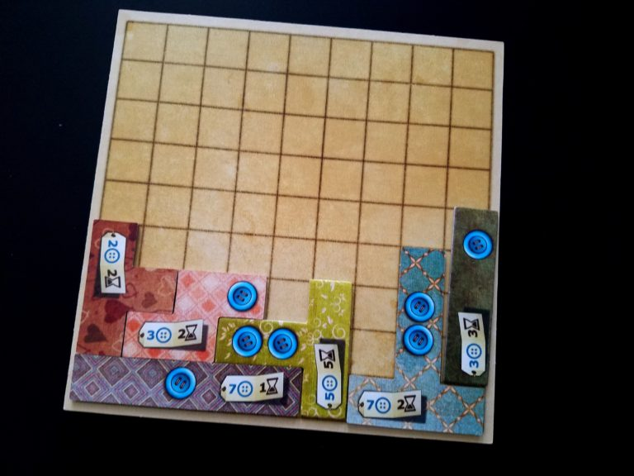
Patchwork
Two player, turn-based board game
Shared board controlling game time
Each player begins with their own empty “Tetris” board
Objective is to fill your board before the game ends
Player with most “money” and most filled board wins

Slide 3
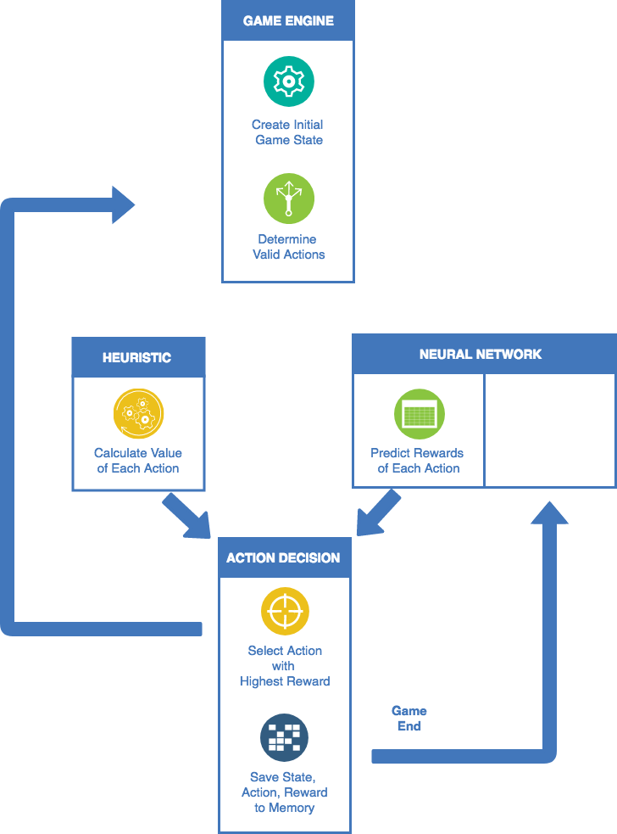
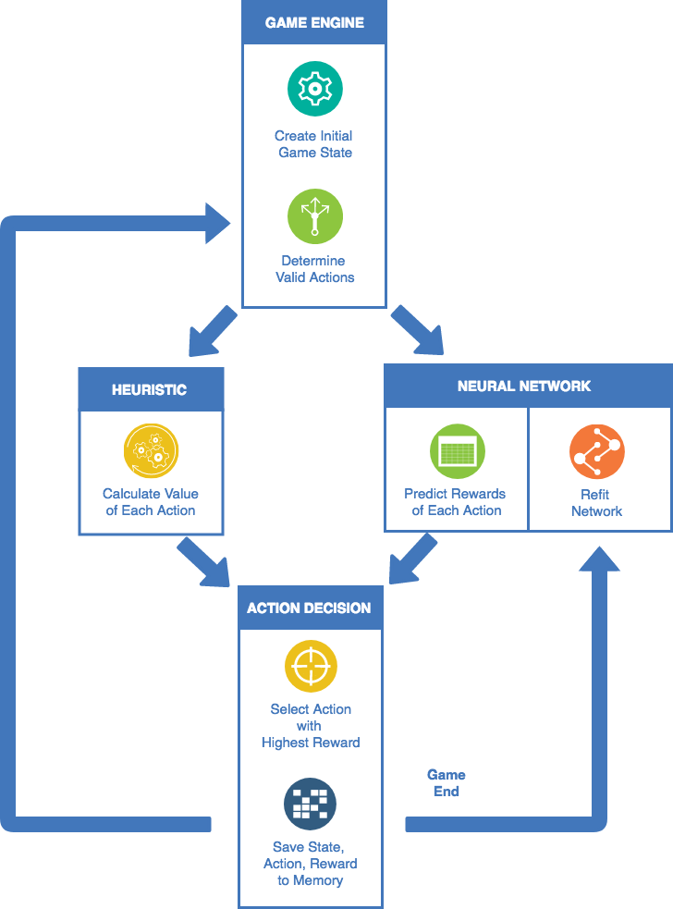
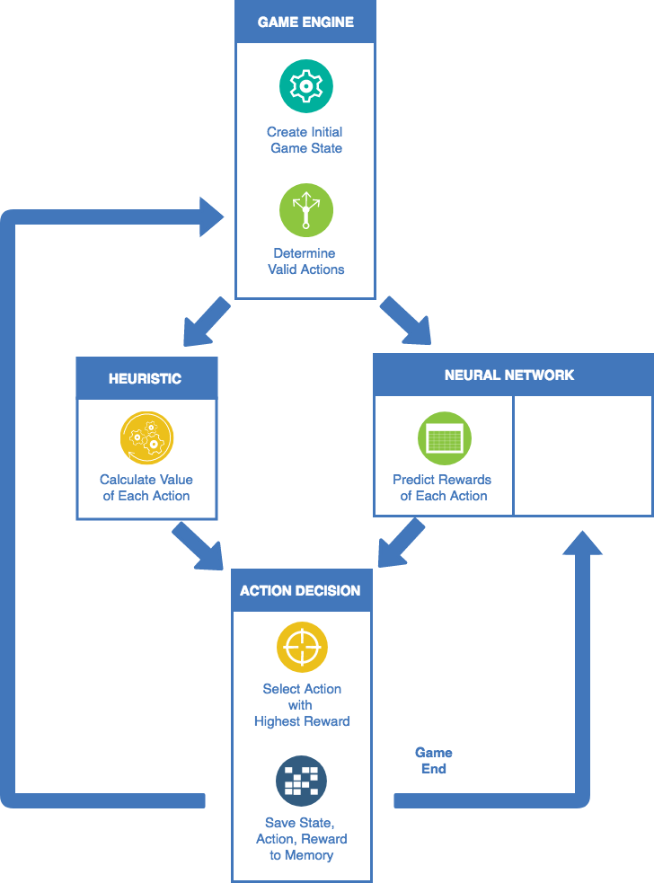
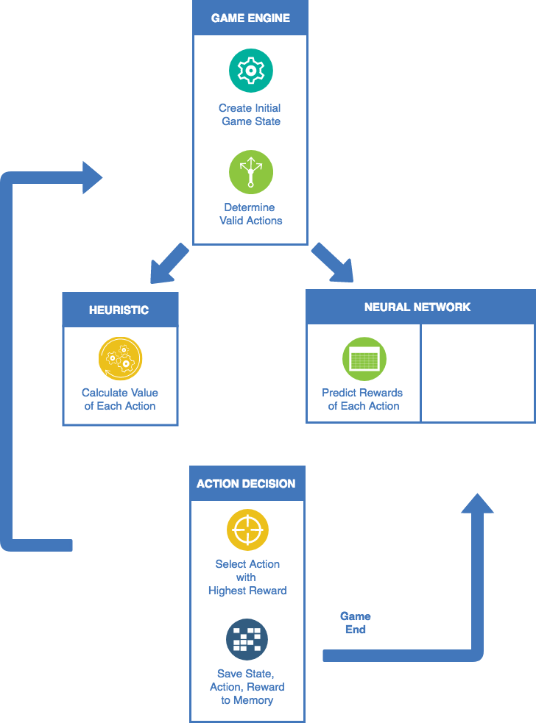
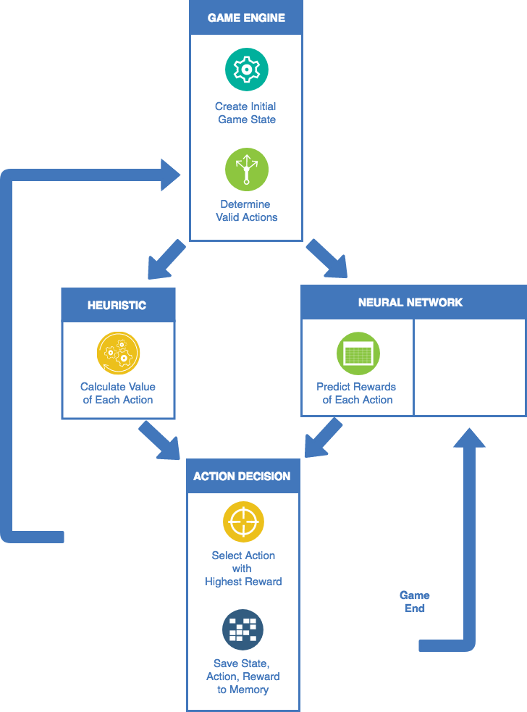
Model

Slide 4
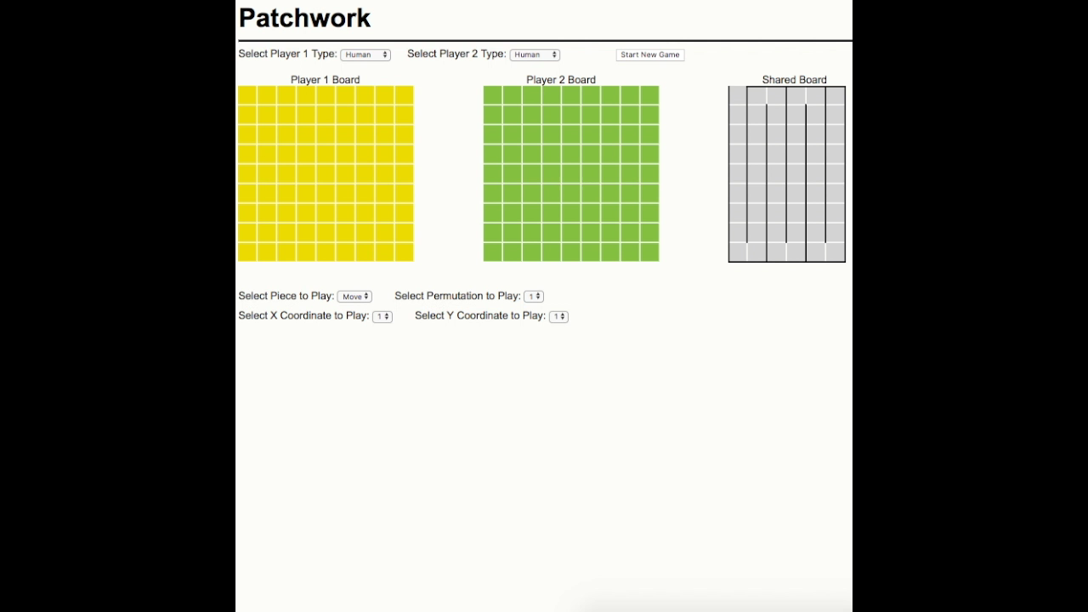
Web Application

Slide 5
Results
Algorithm | Opponent | Algorithm Win Rate
Random | Random | 50%
Model | Random | 95%
Model | Human | 80%
Model | Online - Medium | 50%
Model | Online - Hard | 20%

Slide 6
Thank you!
Browning Gentry

